Slide 1


Sexual Health
HIV Prevention
16 May 2012

Slide 2
Note to facilitator: consider showing your audience the film “HIV and Me” prior to using this PowerPoint slide set.
Get “HIV and Me” film
  SHARP Toolbox CD – Navy and Marine Corps Public Health Center mailto:sharp@nehc.mar.med.navy.mil or call 757-953-0974
  DVD, CD or VHS of the film from Defense Imagery at http://www.defenseimagery.mil/imagery.html
  Order item # 806799

Slide 3

Human Immunodeficiency Virus (HIV) is the virus that causes AIDS
  No cure
  No vaccine
  1 million Americans are living with it
  200,000 don’t know they have it
  50,000 Americans
  are newly infected
  each year

Slide 4

Overview
Who is at Risk of Getting HIV?
How Is HIV Transmitted?
How Will HIV Affect My Life?
How Can I Avoid Getting HIV?

Slide 5
Overview
Upon completion of this lesson, you will be able to:
  Identify who gets HIV
  Identify how HIV is spread
  Identify how HIV can affect life
  Identify how to avoid getting HIV

Slide 6

Who is at Risk of Getting HIV?
How Is HIV Transmitted?
How Will HIV Affect My Life?
How Can I Avoid Getting HIV?

Slide 7
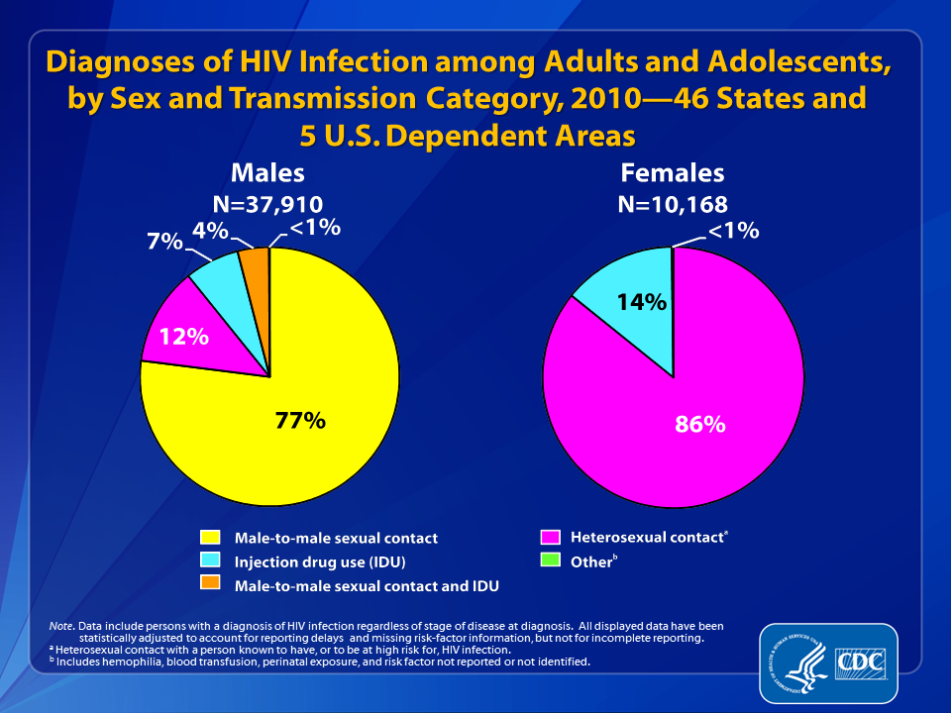
Who is at Risk of Getting HIV?
Anyone exposed to the virus can become infected
Among men:
- 12% got HIV from sex with a woman
  - 77% got HIV from sex with a man
  Men who have sex with men are much more likely to get HIV than are men who have sex with women only because:
    anal sex is very risky
    as many as 1 in 5 men who have sex with men in the U.S. are living with HIV
  Among women, 86% got HIV from sex with a man

Slide 8
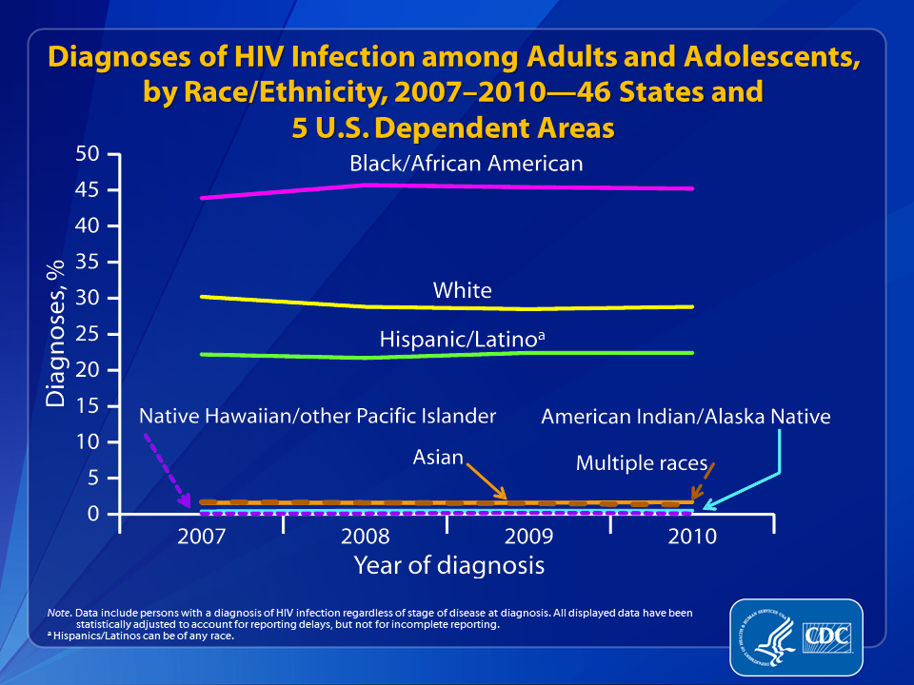
Who is at Risk of Getting HIV?
  In the U.S., black men and women become infected with HIV at higher rates compared to white and Hispanic men and women, probably because their sexual partners are more likely to be infected

Slide 9
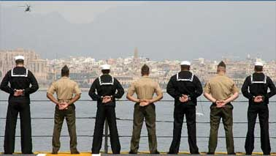
Who is at Risk of Getting HIV?
Sailors & Marines
Since 1985, nearly 6,000 active duty Sailors & Marines have been infected with HIV
  85-100 newly infected each year
  500 HIV positive members are currently on active duty

Slide 10
Who is at Risk of Getting HIV?
Anyone who has sex with or shares needles with a person who has HIV can get HIV
Officer and Enlisted Sailors and Marines have become infected regardless of their gender, sexual orientation and ethnicity
In the U.S. in recent years, 1 of 4 people who was newly infected with HIV is a woman
  Active duty female Sailors and Marines get HIV, but this happens at lower rates than in the US population

Slide 11
Who is at Risk of Getting HIV?
Some people assume sex with a Sailor or Marine is “safe” because Sailors and Marines are tested regularly for HIV
But this is a myth because…
  Active duty members are tested every other year, but…
  Testing does not protect a person from getting HIV and …
  Sailors and Marines who get HIV may remain on active duty

Slide 12

Who is at Risk of Getting HIV?
How Is HIV Transmitted?
How Will HIV Affect My Life?
How Can I Avoid Getting HIV?

Slide 13
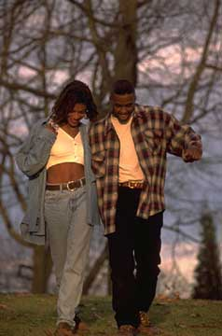
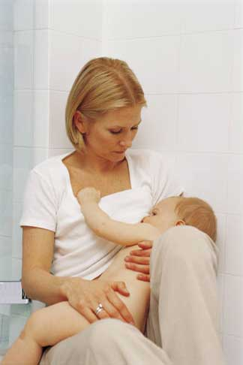
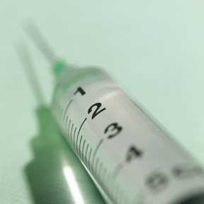
How Is HIV Transmitted?
In Body Fluids
  Semen
  Vaginal fluid
  Rectal (anal) mucous
  Breast milk
Blood

Slide 14
How Is HIV Transmitted?
Modes of Transmission in U.S.
Most Common | Less Common
#1 – Unprotected sexual contact
Blood transfusions (rare in US)
During birth or breast feeding (rare in US)
Sharing needles

Slide 15
How Is HIV Transmitted?
All unprotected sex (no condom) is risky
Whoever receives the fluids is at greatest risk, so…
  Receptive sex is riskier than insertive sex
Anal sex is riskier than vaginal sex
Vaginal sex is riskier than oral sex

Slide 16
How Risky for HIV?
Receptive anal sex High Risk
Insertive anal sex
Receptive vaginal sex
Insertive vaginal sex
Receptive oral sex*
Insertive oral sex* Some Risk

Slide 17
How Is HIV Transmitted?
HIV is NOT transmitted through saliva, tears, hugs, handshakes or on the surfaces of inanimate objects like tools, telephones, toilet seats, etc.
HIV is NOT transmitted through food, water or insects

Slide 18
Who is at Risk of Getting HIV?
How Is HIV Transmitted?
How Will HIV Affect My Life?
How Can I Avoid Getting HIV?

Slide 19
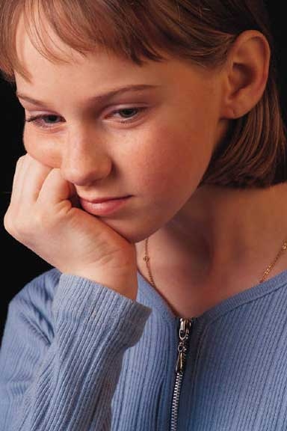
How Will HIV Affect My Life?
Introduction
Your world will be forever changed:
  Personally
  Professionally

Slide 20
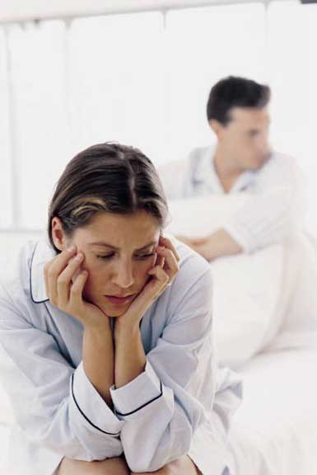
How HIV Can Affect My Life…
Personally
HIV could impact your:
  Health
  Relationships
  Family

Slide 21
How Will HIV Affect My Life?
Personally
Your health will be affected.
“I don’t feel like doing anything. . .because I’m so fatigued from these meds that they give me.”
— HIV-positive Sailor

Slide 22
How Will HIV Affect My Life?
Personally
Your sexual relationships could be affected.
You must:
  Inform past and current sex partners about your HIV status so they may be tested
  Inform any potential new sex partner about your HIV status before intimacy
  Use a condom or abstain from sex

Slide 23
How Will HIV Affect My Life?
Personally
“HIV has affected my personal relationships in a really big way. Where I was able to date freely before, you know, go out and just meet people and not have any secrets to tell them, now it feels like a big secret.”
— HIV-positive Sailor

Slide 24
How Will HIV Affect My Life?
Personally
“HIV has impacted my relationship with my partner in ways I never imagined. The issues involved with intimacy, sex, family planning, and risks have created barriers (both real and perceived) that impact the very essence of our relationship.”
— HIV-positive Sailor

Slide 25
How Will HIV Affect My Life?
Personally
Your relationships with your family, friends, and colleagues may be affected.
“I haven’t told my family yet because I just don’t want to worry them. My folks are old, and they don’t need to worry about this right now. I know that this would be very disappointing to them.” — HIV-positive Sailor

Slide 26
How Will HIV Affect My Life?
Professionally
Your career may be affected:
  Assigned only to non-deployable billet
  CONUS or Hawaii
  No commissioning opportunities
“Prior to me finding out about my HIV status I was in pursuit of a commissioning program. My HIV status now disqualifies me from becoming a commissioned officer. So that was pretty hard because that was my ultimate goal, coming into the Navy.” — HIV-positive Sailor

Slide 27
Who is at Risk of Getting HIV?
How Is HIV Transmitted?
How Will HIV Affect My Life?
How Can I Avoid Getting HIV?

Slide 28

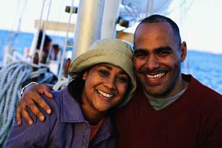
How Can I Avoid Getting HIV?
Introduction
HIV is preventable!
Know the facts – act on these facts – and reduce your risk of getting HIV.

Slide 29

How Can I Avoid Getting HIV?
Delay Sex
One way to avoid getting HIV is to say no sex; or delay sex until another time in your life.

Slide 30
How Can I Avoid Getting HIV?
Outercourse rather than Intercourse
You can show affection without having sex
  Outercourse is anything that is non-penetrative
  For example: hugging, kissing, massage, holding hands, love letters, phone calls
Outercourse is much safer than intercourse

Slide 31

How Can I Avoid Getting HIV?
Practice Monogamy
Only have sex in a long-term, mutually monogamous relationship.
For this to work,
both partners
must be faithful.

Slide 32

How Can I Avoid Getting HIV?
Practice Monogamy
A monogamous relationship should be long term and well-established.

Slide 33
How Can I Avoid Getting HIV?
Practice Monogamy
Some people have monogamous relationships with every person they date; but their relationships are short term
These people may think they are “safe,” but they may not be
Many short-term relationships involving sex without condoms, even if they are monogamous, means exposure to many people over time

Slide 34
How Can I Avoid Getting HIV?
Practice Monogamy
Don’t make the mistake that so many couples do and use a condom only the first time and then stop because “you’re a couple now.”

Slide 35
How Can I Avoid Getting HIV?
Practice Monogamy
Continue using condoms until your new relationship has had time to develop into one of mutual trust.
Then, consider getting tested for HIV together.

Slide 36
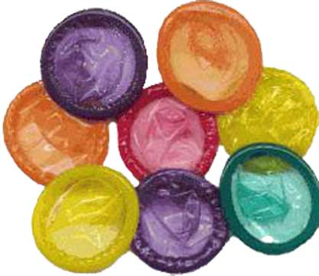
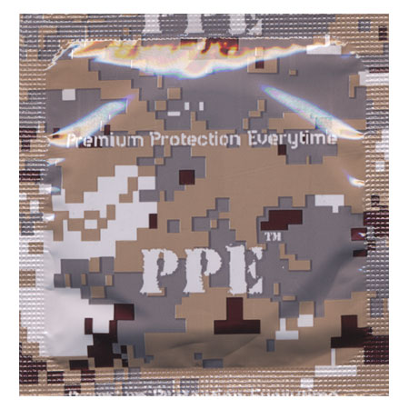
How Can I Reduce My Risk of Getting HIV?
Use condoms correctly and every time
If saying no to sex and monogamy are not right for you at this time in your life, you can reduce your risk:
  always have condoms readily available, and
  use a condom correctly every time you have sex.

Slide 37
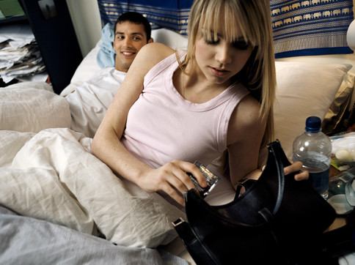
How Can I Reduce My Risk of Getting HIV?
Use condoms correctly and every time
Condoms require
some advance
planning.
Male or female, if you are sexually active, have condoms with you; your health is your responsibility.

Slide 38
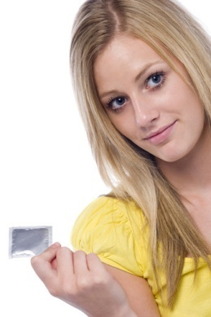
How Can I Reduce My Risk of Getting HIV?
Use condoms correctly and every time
Always:
  Use a new condom for each act of
  vaginal, anal, or oral intercourse
  Put the condom on before penetration
  Unroll the condom by pinching the tip of the condom to create space at the tip
  Do NOT use oil-based lubes like Vaseline or baby oil with latex condoms
  After ejaculation, hold the condom firmly at the base of the penis and withdraw while erect

Slide 39
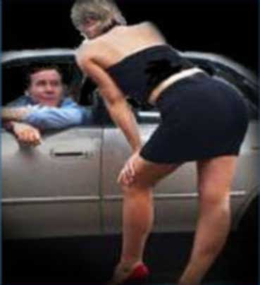
How Can I Reduce My Risk of Getting HIV?
In addition to using a condom, reduce risk by:
  Have sex with fewer people
  Avoiding high-risk partners
    people who accept
    money for sex
    People who may have
    had multiple partners
  Avoid highest risk sex acts
    Riskiest is unprotected receptive anal sex

Slide 40
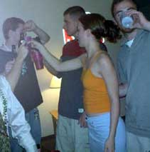
How Can I Reduce My Risk of Getting HIV?
Alcohol clouds your judgment, making you susceptible to
bad decisions.
Avoid or limit your
drinking to keep a
clear head so you
can stick to your
HIV-prevention plan.

Slide 41
Summary of Risk Reduction Options
You can eliminate HIV risk:
  Delay sex until another time in your life
  Have outer-course rather than intercourse
  Practice monogamy with an uninfected partner / be faithful
You can reduce HIV risk:
  Use and use condom every time
  Have sex with fewer people
  Don’t trade money for sex
  Avoid sex with people who may have had many other sex partners
  Avoid high risk sex acts
Stay sober and in control

Slide 42
Remember:
  Anyone can get HIV, especially those who are sexually active
  If you get HIV, your personal life and career change forever
  HIV is preventable
  Your choices determine your risk of getting HIV

Slide 43
Summary
Who is at Risk of Getting HIV?
How Is HIV Transmitted?
How Will HIV Affect My Life?
How Can I Avoid Getting HIV?

Slide 44


Comments or questions may be sent to:
Navy and Marine Corps Public Health Center
Sexual Health and Responsibility Program (SHARP)
620 John Paul Jones Circle, Suite 1100
Portsmouth VA 23708
(757) 953-0974; DSN 377
mailto:sharp@nehc.mar.med.navy.mil
SHARP – ‘Chart a safe Course’

